Slide 1
Ethical Issues
Women's Right to have Abortion

Slide 2

Women's Right to have Abortion
Abortion is a controversial topic in the United States.
Women are the owners of their bodies (Segers & Byrnes, 2016).
Women carry the foetus for nine months.
It is ethical to grant women full rights for them to be content.
Notes:
Abortion in the United States remains to be a controversial topic among many groups of persons (Segers & Byrnes, 2016). There is an argument that women should be allowed to have abortions since they are the owners of their bodies. In addition, they should be allowed to decide what they want with the pregnancy at any given time.

Slide 3
Dilemmas or Concerns on Women's Right to have Abortion
Abortion violates the timing on motherhood.
Abortion is regarded as a form of murder (Bergallo & Ramón Michel, 2016).
It devalues the importance of children in society.
It denies a potential life the opportunity to continue developing.
Notes:
Abortion devalues the chance of women to become mothers after a specific time, which is unethical (Bergallo & Ramón Michel, 2016). On the same note, abortion denies life, and as such, this is seen as immoral. Children remain to be essential in many societies since they are regarded as future leaders. Therefore, abortion tends to devalues their importance and roles in society.

Slide 4
My Rationale on The Issue
Women are part and parcel of society hence the need to grant them the opportunity to make critical decisions that matter a lot in their lives. In other words, women should be given rights to have an abortion based on any given time. I think that forcing women to keep the pregnancies yet they are unwilling will only get things worse. The children will end up abandoned and adopted in child help services. Hence, I affirm to the point that women should be allowed to have an abortion comfortably without being restricted or threatened.

Slide 5
The Key Stakeholders and Factors in Support of the Issue
Policy makers.
The government (Segers & Byrnes, 2016).
Freedom and Choices.
Rights.
Notes:
Policy makers and the government serves as fundamental stakeholders who can influence the stance through supporting it in debates and in the media (Segers & Byrnes, 2016). As such, they will fund the acceptance of abortion for women. Both the freedom and rights should be regarded as critical factors that influences women’s rights to abort and give them an opportunity to do what they want with their bodies.

Slide 6
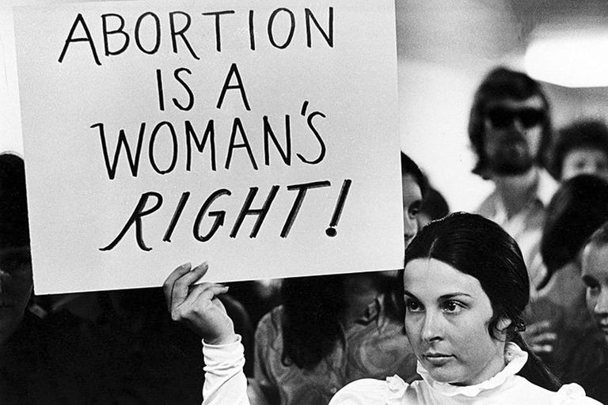
Ethical Principles Involved
Nonmalefinence is related to women’s right to abort.
The good things in society must outweigh the bad ones.
The action itself must not be intrinsically wrong but should be a good or neutral act (Bergallo & Ramón Michel, 2016).
Only the good effect must be intended, not the bad effect.
Notes:
The action itself must not be intrinsically wrong, it must be a good or neutral act (Bergallo& Ramón Michel, 2016). Only the good effect must be intended, not the bad effect, even though it is foreseen.

Slide 7
Access as a Policy Driver
Health care services should be accessible to all women.
Women in marginalized areas should enjoy care.
Women should easily access birth control medications.
Access to health is a moral right (Bergallo & Ramón Michel, 2016).
Notes:
All women who are willing to access to access birth control pills should easily be allowed to do it (Bergallo & Ramón Michel, 2016). On the same note, physicians should aim at providing care to women willing to conduct abortions. Therefore, safety for wimen will be promoted.

Slide 8

Consequence Based (Utilitarian)
It focuses on promoting what one believes is right (Francome, 2016).
It maximizes one’s happiness.
Women should conduct abortion at any given time.
Women should do what their wish with their bodies.
Notes:
Consequence Based (Utilitarian) ethical theory aims to allow women do what they want with their bodies as far as abortion is concerned (Francome, 2016). As such, the central goal is to maximize happiness and minimize suffering for the most people.

Slide 9
Conclusion
Women should be allowed to practice abortion.
It is ethical to grant them freedom.
Women should control their bodies.
Healthcare givers should aid women to have safe abortions.
Notes:
It is the women's right to have abortion, and as such, they should be allowed to conduct it at any given time. Policy makers and the government are critical in this issue since they have the power and influence to initiate policies that support women to conduct abortions without feeling the pressure.

Slide 10
References
Bergallo, P., & Ramón Michel, A. (2016). Constitutional developments in Latin American abortion law. International Journal of Gynecology & Obstetrics, 135(2), 228-231.
Francome, C. (2016). Unsafe Abortion and Women's Health: Change and Liberalization. Routledge.
Segers, M. C., & Byrnes, T. A. (2016). Abortion politics in American states. Routledge.

Slide 11
Presented by;

